Slide 1
ACTIVEZONE
ASWIN C S – PEC22CS018
AL AMEEN N – PEC22CS005
ANANYA KRISHNAN – PEC22CS010
ARATHY R – PEC22CS011
GUIDE :Mrs RANA SURENDRAN,
(ASSISTANT PROFESSOR IN CSE)

Slide 2
TABLE OF CONTENTS
1.INRODUCTION……………………………………………………........................3
2.EXISTING SYSTEM……………………………………………………………...........4
3.PROBLEM STATEMENT.……………………………………………………………...6
4.PROPOSED SYSTEM,OBJECTIVES & SCOPES…………………………………7
5.REQUIREMENT ANALYSIS………………….……………………………………….9
6.METHODOLOGY…………………………………………………………….............10
7.ADVANTAGES OF PROPOSED SYSTEM………………………………………….13
8.SYSTEM DESIGN………………….……………………………………………………15
9.IMPLEMENTATION………………….………….……………………………………..19
10.RESULTS AND DISCUSSIONS………….…………………………………….....22
11.CONCLUSION AND FUTURE SCOPE…………………………………………..23
12.REFERENCES………………………………………………………………………....24

Slide 3
1.INTRODUCTION
In today's digital era, technology has transformed various industries, including sports and recreation. An Online Turf Booking System is a web or mobile-based application designed to streamline the process of booking sports turfs, making it more efficient and user-friendly.
Traditionally, booking a turf involved making phone calls, visiting the venue, or dealing with manual reservations, which often led to scheduling conflicts and inefficiencies. With an online booking system, users can check real-time availability, make instant reservations, and complete payments online, reducing the hassle of traditional booking methods.
This mini-project aims to develop a simple yet effective turf booking system that enables users to book slots conveniently while providing turf owners with a seamless management solution. The system will feature user authentication, slot selection, online payment integration, and booking confirmation, ensuring a smooth experience for both players and turf managers.
By implementing this project, we aim to enhance accessibility, improve operational efficiency, and encourage more people to engage in sports activities through a hassle-free booking experience.

Slide 4
2.EXISTING SYSTEM
Currently, turf booking is handled manually, leading to several inefficiencies:
Manual Booking Process
  Users book turfs via phone calls, WhatsApp, or in-person visits.
  No centralized system to manage bookings.
Lack of Availability Tracking
  Users have no real-time visibility of turf availability.
  Overlapping bookings and scheduling conflicts occur.
Payment Issues
  Payments are mostly done in cash or via manual transfers.
  No secure online payment integration.
No User-Friendly Interface
  No digital platform for booking, cancellations, or management.
  Users rely on direct communication, which is time-consuming.

Slide 5
Miscommunication & Inefficiency
  Booking details are often lost or misunderstood.
  Turf owners and users struggle with unclear confirmations.
Limitations of the Existing System:
Time-consuming and inefficient.
No automated booking confirmation.
No proper record-keeping.
Inconvenient for both users and turf owners.

Slide 6
3.PROBLEM STATEMENT
The inefficiency and complexity in managing turf facilities within a pre-defined time slot.

Slide 7
4.PROPOSED SYSTEM,OBJECTIVES AND SCOPE
4.1 Proposed system
The proposed system, ACTIVEZONE, is an automated online turf booking platform designed to eliminate inefficiencies in the existing manual process. It provides users with a seamless way to find and book available turfs with real-time updates and secure transactions.
✅ Key Features of ACTIVEZONE:
  Online Booking System – Users can book turfs anytime from a centralized platform.
  Real-Time Availability Check – Prevents double bookings and scheduling conflicts.
  Secure Online Payments – Integrated payment gateway for smooth transactions.
  User & Turf Management – Admin panel for handling users and turf registrations.
  Automated Booking Confirmations & Notifications – Users receive instant confirmations via email/SMS.
  4.2Objective
  The main objective of ACTIVEZONE is to provide a user-friendly and efficient turf booking system that enhances the overall experience for both users and turf owners.

Slide 8
  🎯 Key Objectives:
    To develop an easy-to-use online booking system.
    To provide real-time updates on turf availability.
    To enable secure and seamless online payments.
    To improve the booking management process for turf owners.
    To reduce manual errors, miscommunication, and inefficiencies.
    4.3Scope
    ACTIVEZONE is designed to streamline and digitalize the turf booking process for both users and turf owners.
    🔹 Scope of ACTIVEZONE:
      Allows users to book turfs conveniently through an online platform.
      Enables turf owners to manage bookings, track availability, and handle payments efficiently.
      Supports automated scheduling, reducing manual intervention.
      Enhances user experience with real-time notifications and booking confirmations.
      Ensures secure transactions for users.

Slide 9
5. REQUIREMENT ANALYSIS- Hardware & Software Requirements
🔹Hardware Requirements
  A minimum of 4GB RAM and a dual-core processor to handle user requests efficiently.
  Stable internet connection to support online bookings and real-time GPS tracking.
  Accessible on desktops,laptops,tablets,and smartphones via a web or mobile application.
🔹 Software Requirements
  Operating System: Windows / macOS / Linux (for development & deployment).
  Backend Framework: Django (Python-based) for handling server-side logic.
  Database: PostgreSQL for storing user, turf, and booking details.
  Frontend Technologies: HTML, CSS, JavaScript for UI design.

Slide 10
6.METHODOLOGY : Module Description
User Module
  Registration: Users can sign up with their email,phone number and password.OTP verification (if applicable) ensures security during registration.
  Authentication: Secure log in and log out functionality using the registered credentials(email/phone and password) .
  Profile management: Users can update personal informations and manage their account settings.
2. Turf Search & Discovery Module
  Users can search for turfs by location.
  Filters allow selection based on pricing, facilities, and ratings.
  Live Availability Updates:Turf owners can update real-time slot availability,ensuring accurate information for users and preventing overbookings.
  Turf Details Page:Each turf has a dedicated page displaying-images,location,pricing and available slots,facilities and user guidelines.

Slide 11
3.Booking & Turf Management Module
  Slot Selection & Booking – Users select available time slots and confirm bookings.
  Secure Payment & Confirmation – Payments are processed online, and users receive a confirmation email/SMS with booking details (including Booking ID).
  Booking History – Users can view past bookings, cancel bookings as per turf policies.
4. Turf Management Module
  Turf Availability Control – Turf owners can update available slots and block slots for maintenance.
  Booking Approval System – Turf managers can approve or reject bookings based on demand and availability.

Slide 12
5.Admin Module
  User Management – Admins can view, edit, or deactivate user accounts if necessary.
  Turf Approval & Verification – Admins verify and approve new turf registrations.
  System Logs & Monitoring – Track user activity, payments, and booking logs.
  Reports & Analytics – Generate reports on user engagement, booking trends and revenue insights.
  Dispute Resolution-Handling customer complaints regarding cancellations, refunds, or disputes.
Ensuring a smooth resolution process between users and turf managers.

Slide 13
7.ADVANTAGES OF PROPOSED SYSTEM
Enhanced User Convenience
  Users can book turfs anytime, anywhere through an easy-to-use online platform.
  Eliminates the need for manual calls or physical visits to book a turf.
Real-Time Turf Availability & Booking
  Users can check real-time availability of turfs and instantly book slots.
  Prevents double bookings and scheduling conflicts.
Secure & Seamless Payment System
  Integrated online payment gateway for hassle-free transactions.
  Provides users with instant booking confirmations via email/SMS.
Efficient Turf Management
  Turf owners can update slot availability and close turfs for maintenance.
  Owners have better control over their turf bookings and earnings.

Slide 14
  Reduced Manual Errors & Miscommunication
    Automates the entire booking process, minimizing human errors.
    Avoids confusion caused by overlapping bookings or mismanaged slots.
  Improved User & Turf Owner Engagement
    Users can rate and review turfs,helping others make informed decisions.
    Turf owners receive feedback to improve their services and facilities.
  Admin Monitoring & Analytics
    Admins can track user activity, booking trends, and revenue insights.
    Helps in system improvements and dispute resolution.

Slide 15
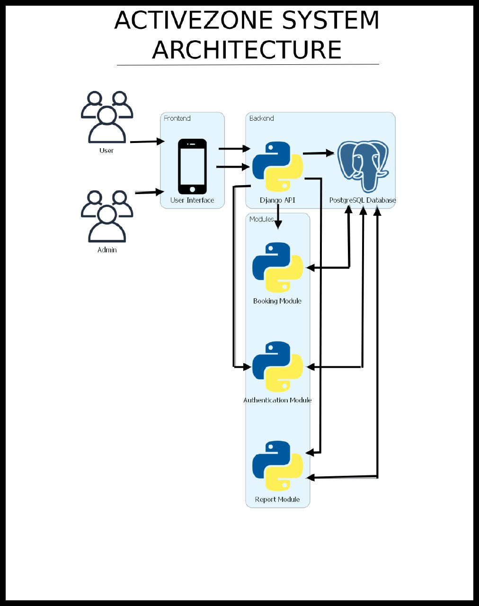
8.SYSTEM DESIGN

Slide 16
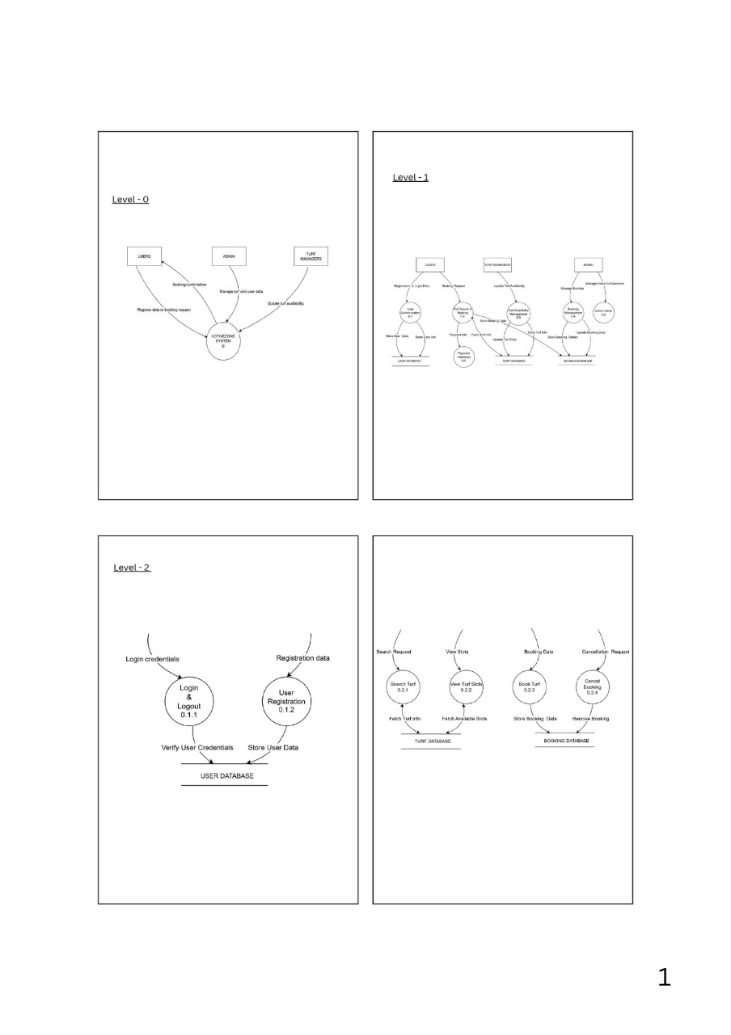
DATA FLOW DIAGRAM

Slide 17
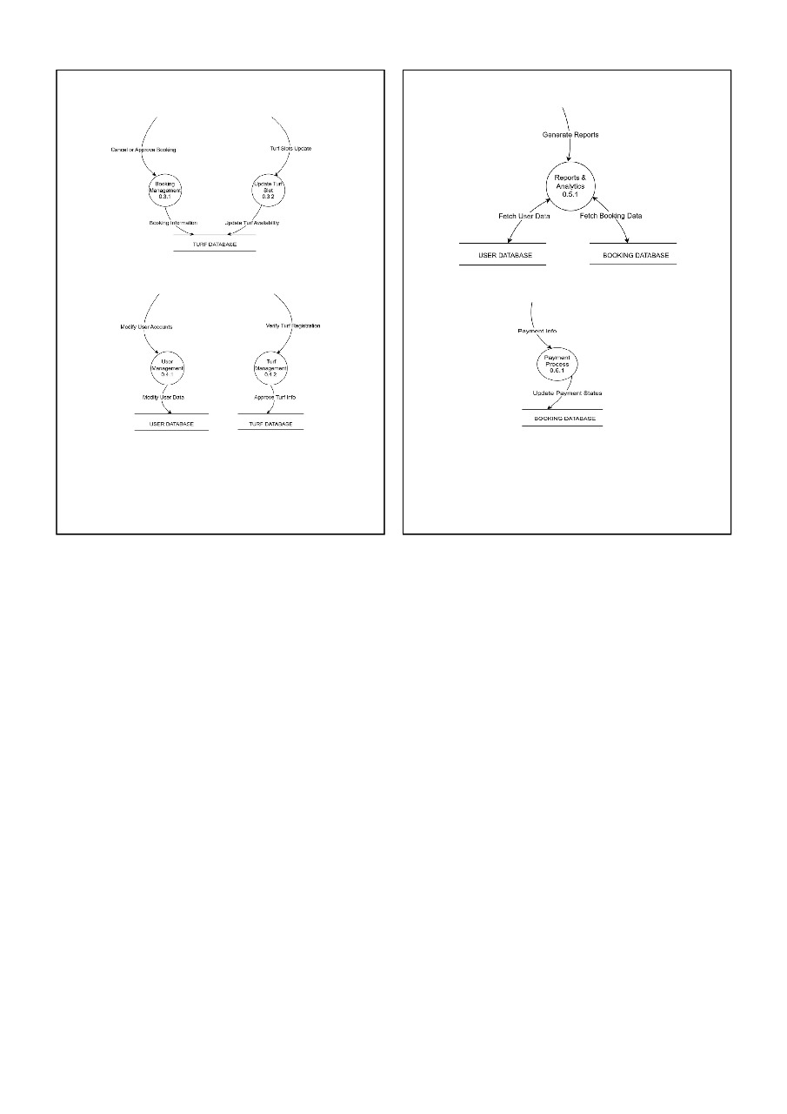

Slide 18
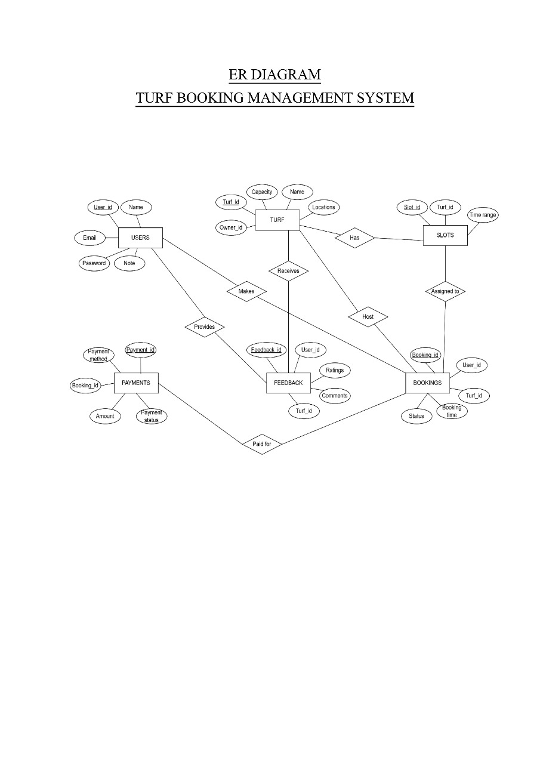

Slide 19
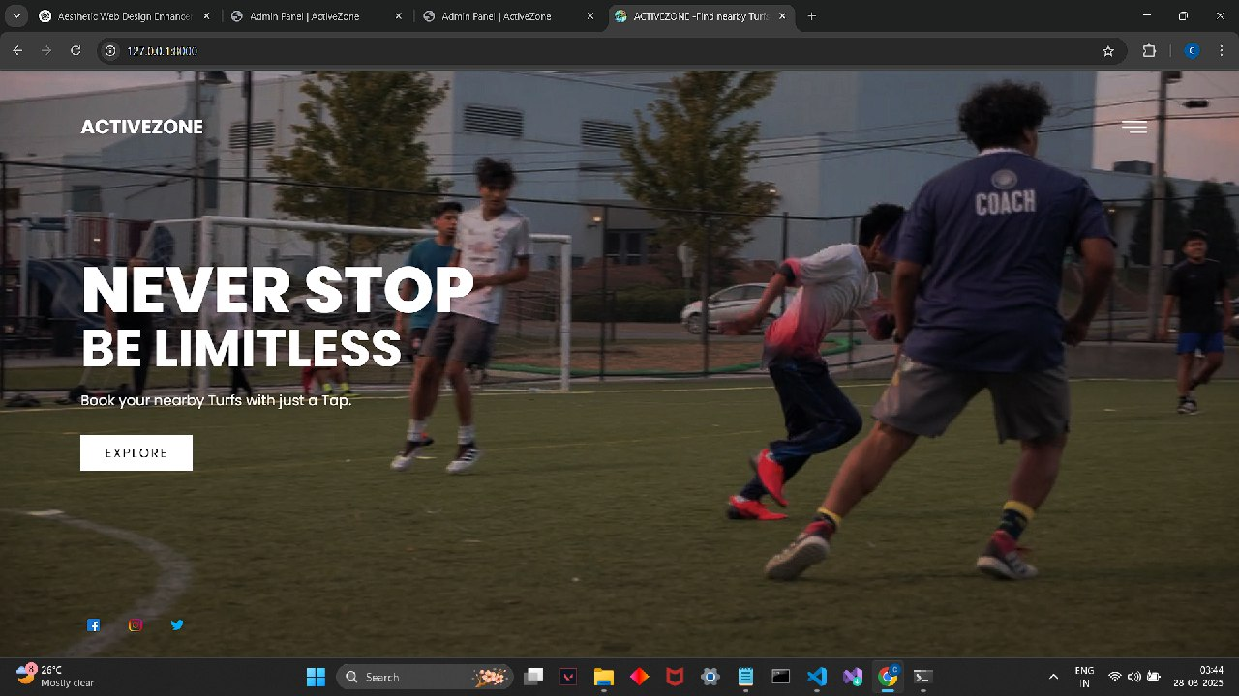
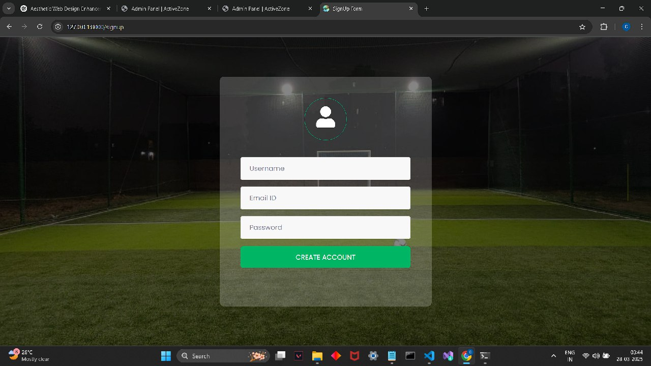
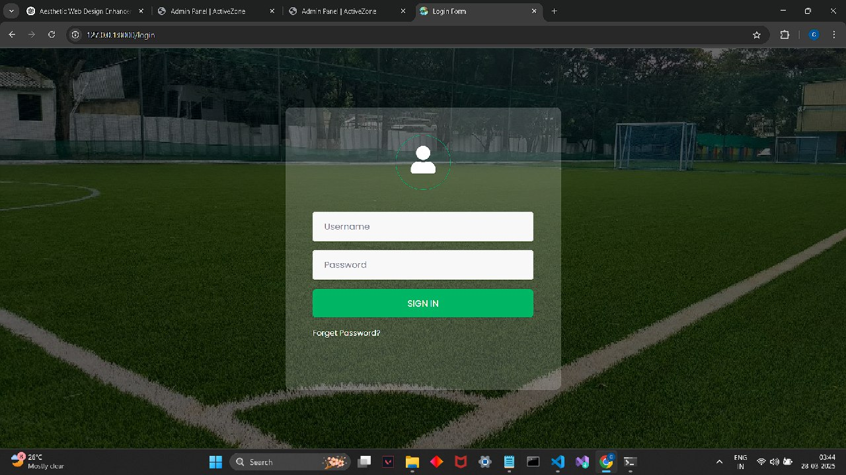
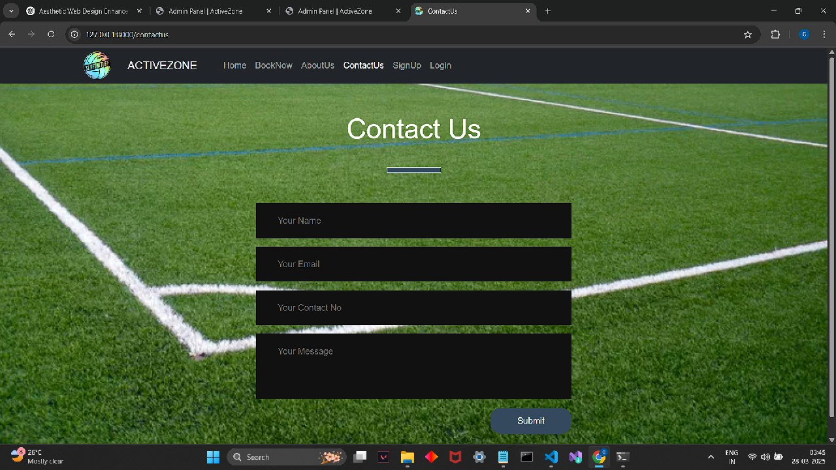
9.IMPLEMENTATION

Slide 20
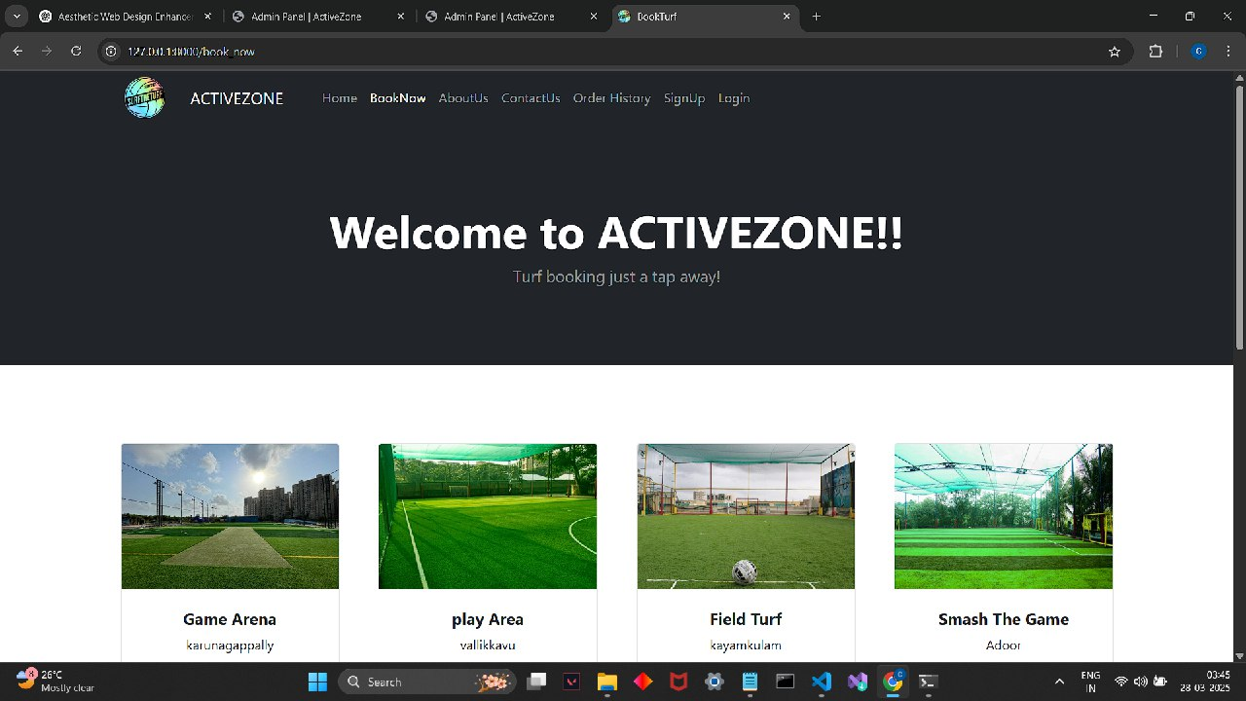
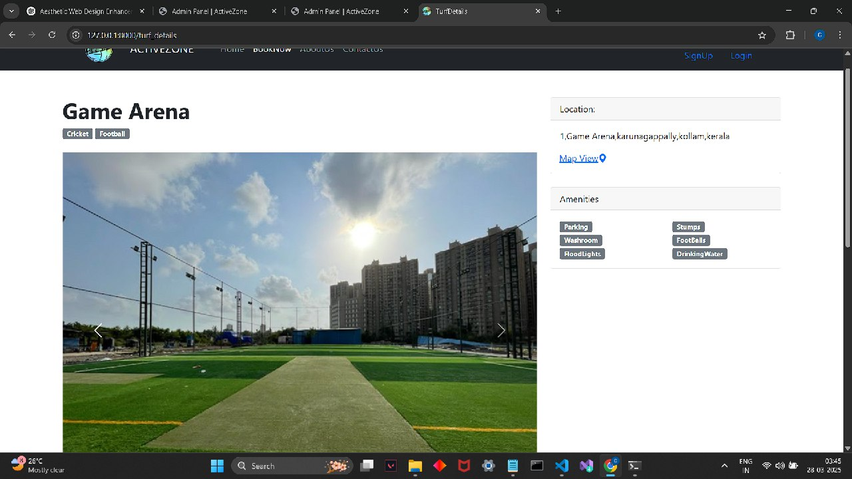
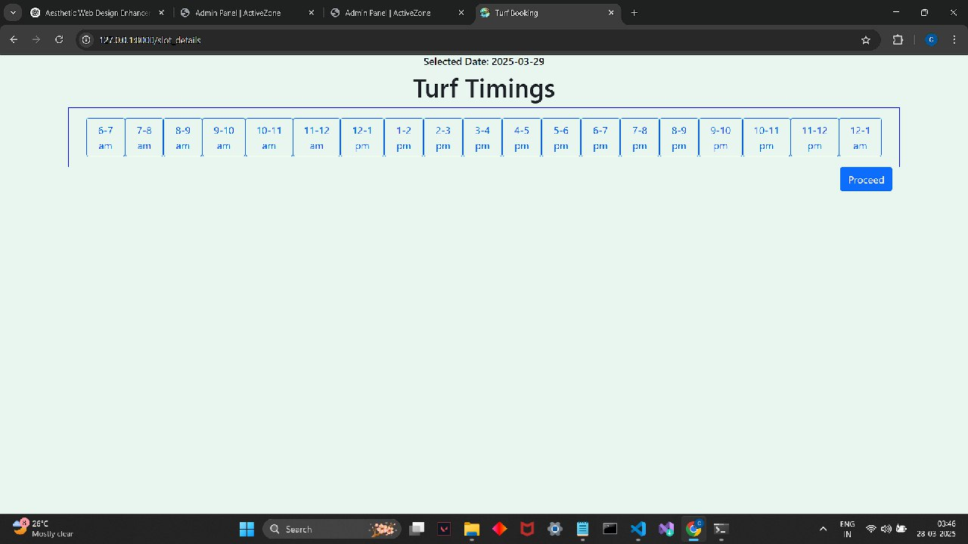
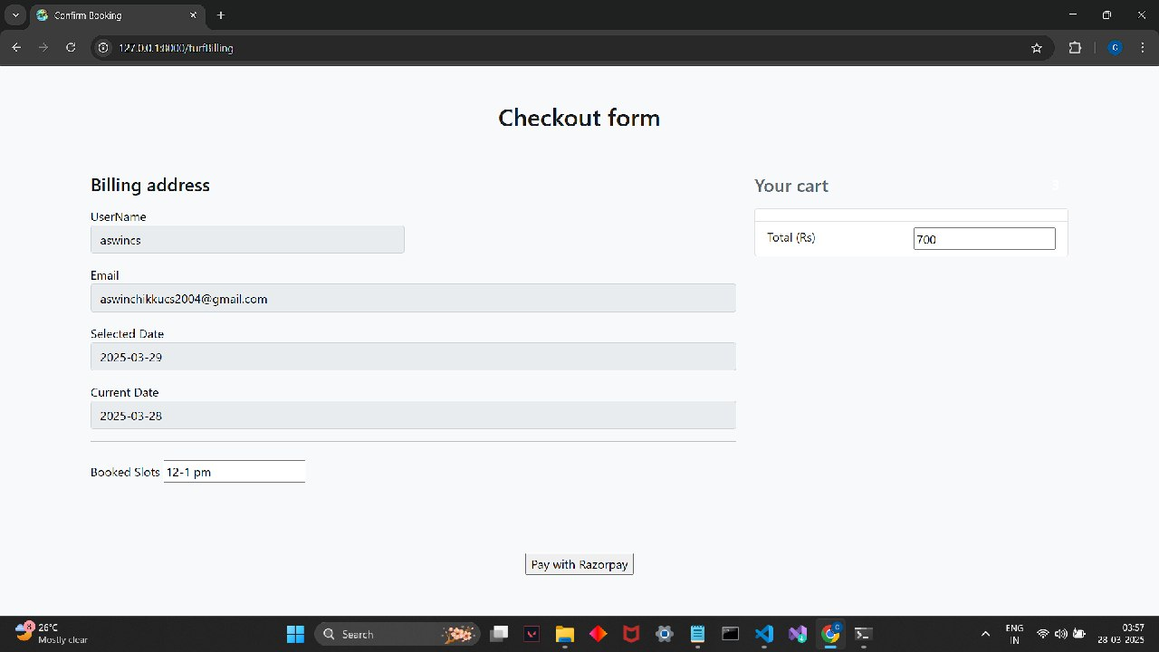

Slide 21
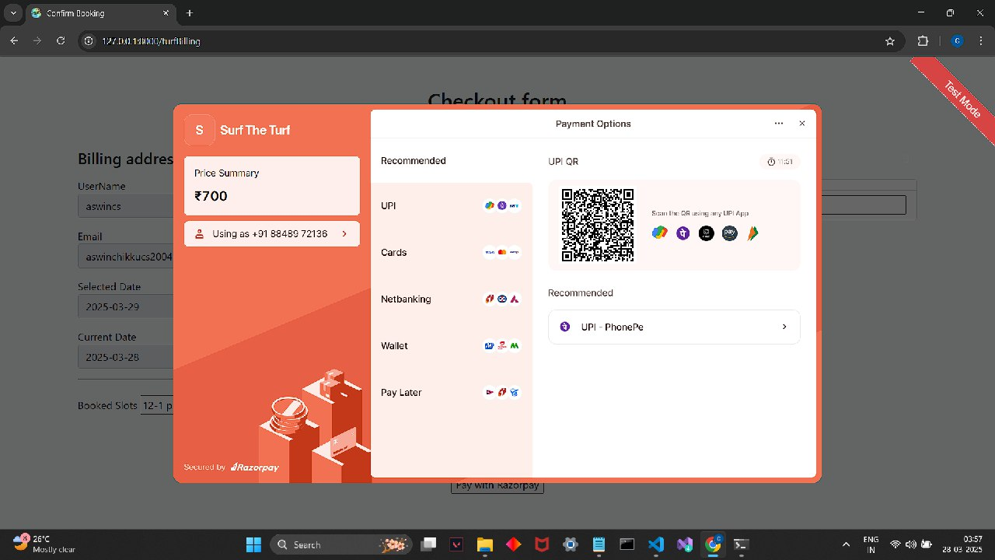
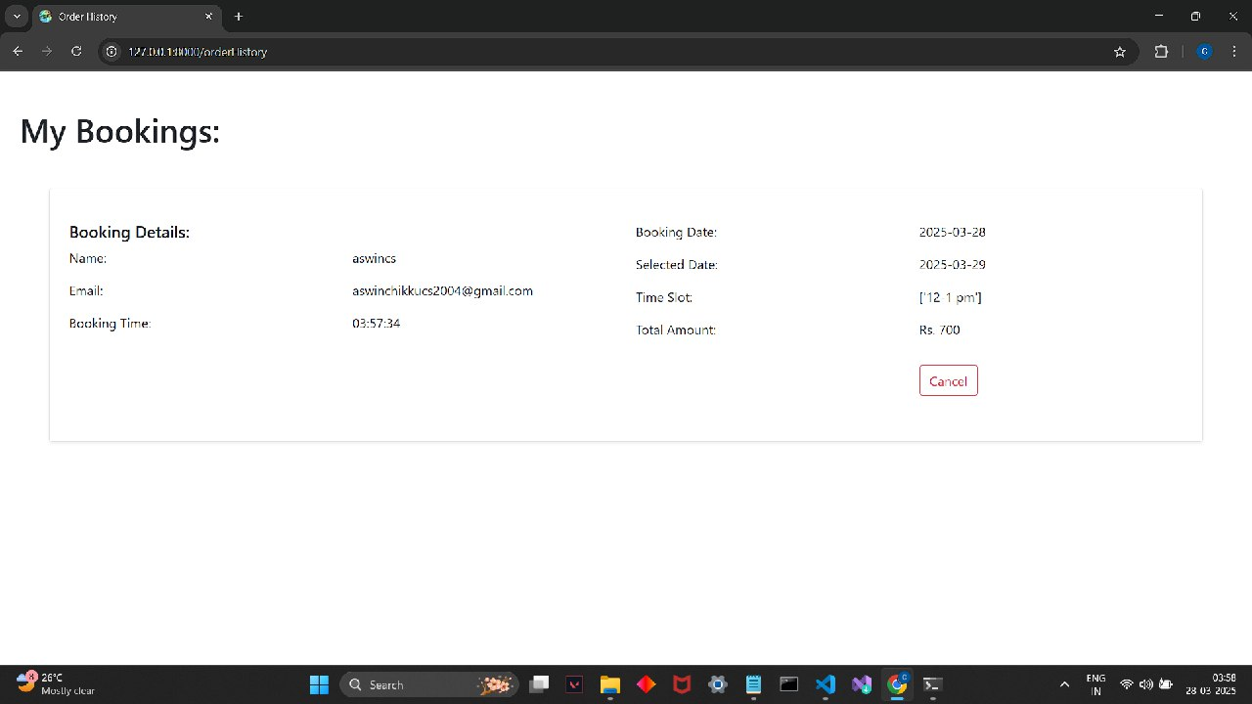
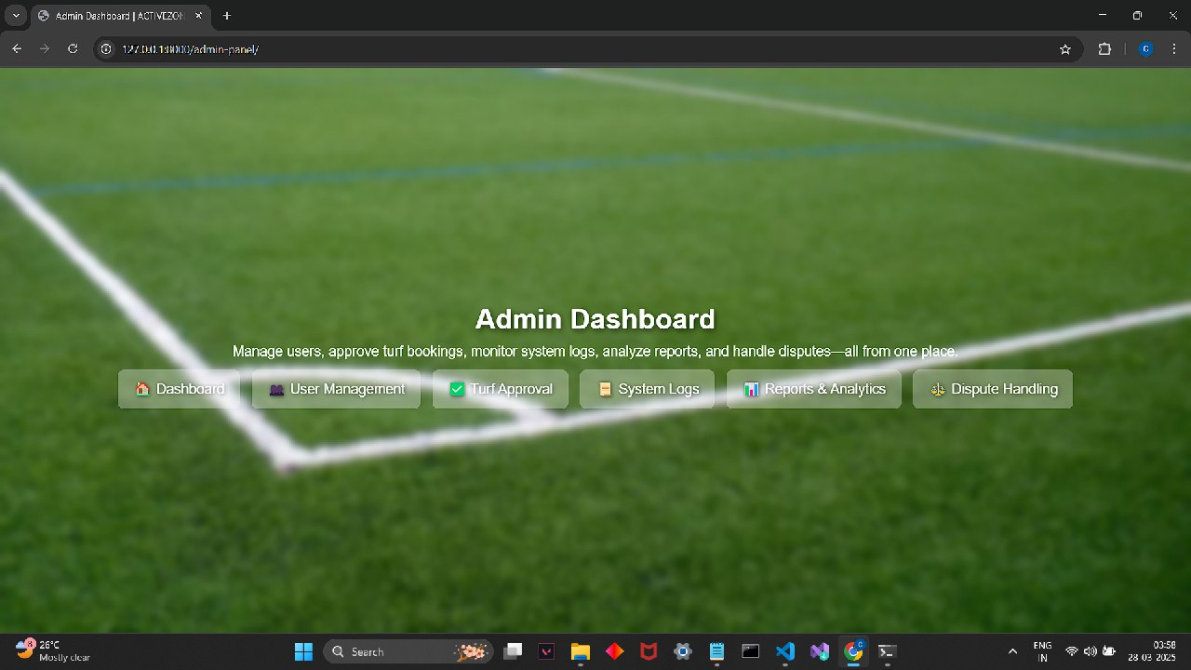

Slide 22
10.RESULTS AND DISCUSSIONS
Results
  Seamless User Experience: Users can register, search for turfs, and book slots efficiently.
  Real-Time Turf Availability: Users get accurate slot availability updates.
  Secure Booking & Payment System: Ensures safe transactions and booking confirmations.
  Turf Owner & Admin Management: Owners manage bookings, while admins oversee the system.
  Improved Accessibility & Convenience: Eliminates manual booking hassles, making turf reservations easier.
Discussion
  The system successfully automates turf booking, reducing human errors.Users experience real-time updates, leading to higher satisfaction and trust.Future improvements can include features like AI-based recommendations & analytics for booking trends.

Slide 23
11.CONCLUSION AND FUTURE SCOPE
🔹 Conclusion
  The proposed system provides a seamless and efficient way to book turfs online.
  It enhances user convenience by offering real-time slot availability, secure payments, and automated booking confirmations.
  Turf owners benefit from better booking management and revenue tracking.
  The system reduces manual errors and miscommunication, ensuring a smooth booking process.
  Admin functionalities help in system monitoring, user management, and dispute resolution.
🔹 Future Scope
  AI-based Booking Recommendations – suggesting turfs based on user preferences and past bookings.
  Mobile App Integration – Extending the system with a dedicated mobile application for a better user experience.
  Dynamic Pricing System – Implementing flexible pricing based on demand and peak hours.
  Loyalty & Reward System – Encouraging repeat bookings with discounts and reward points.

Slide 24
12.REFERENCES
Books & Research Papers:
  Sommerville, I. (2015). Software Engineering (10th ed.). Pearson.
  Pressman, R. S. (2019). Software Engineering: A Practitioner’s Approach (9th ed.). McGraw-Hill.
Web Sources:
  Django Documentation – https://docs.djangoproject.com/
  PostgreSQL Documentation - https://www.postgresql.org/docs/

